Slide 1
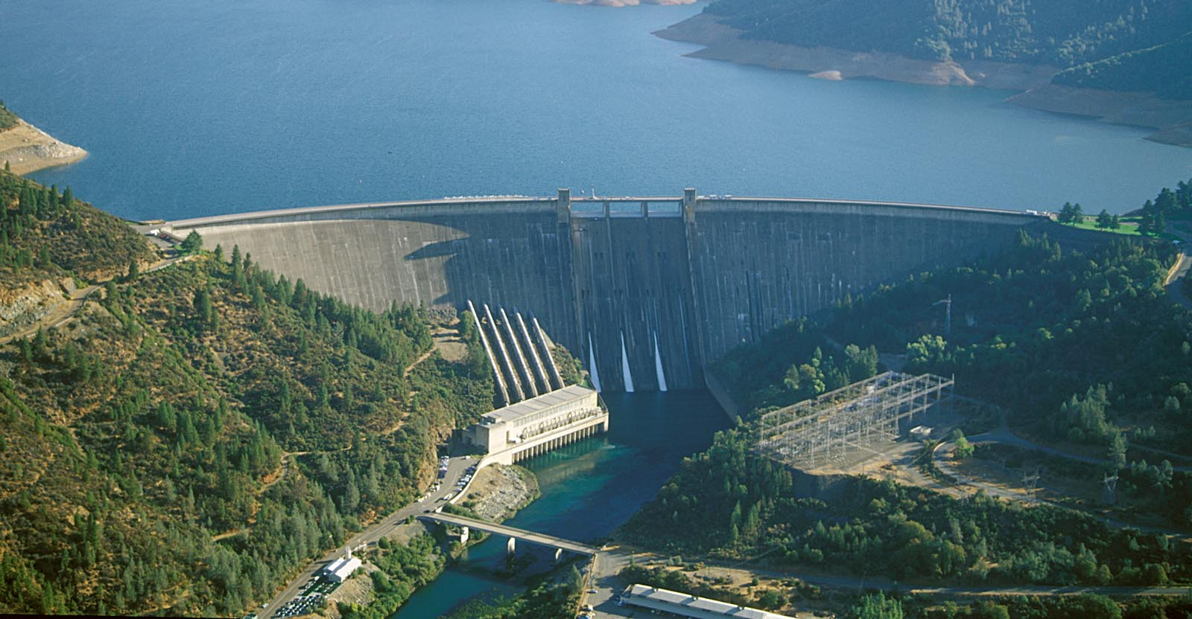
From Data Science to Hydrology: California Reservoirs During Drought
Armeen Taeb (Caltech)
Joint work with: Venkat Chandrasekaran (Caltech), John Reager (JPL)
Michael Turmon (JPL)
Notes:
Thank you for the opportunity to speak here. This talk will be about leveraging tool from data science to understand reservoir behavior during drought

Slide 2
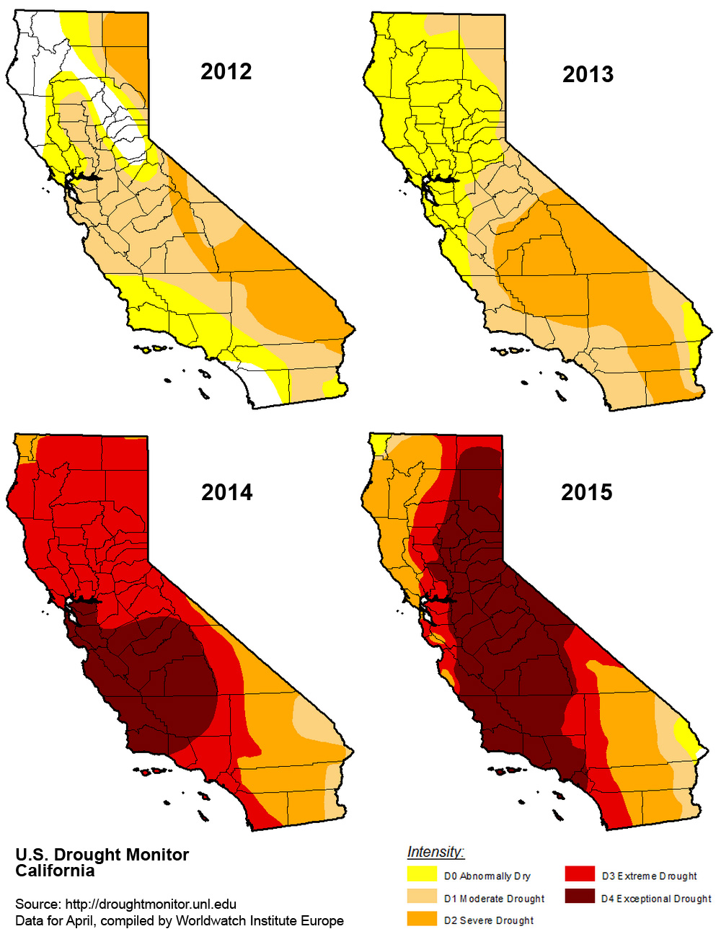
Drought in California
2012-2015 was the most intense 4-year drought in the past 1200 years
January 2014: Jerry Brown declared a drought state of emergency
Notes:
It wasn’t so long ago when California was in the middle of a historic drought. In particular, 2012-2015 was the most intense 4-year drought in the past 2000 years. The diagram to the right shows the severity of drought, where light yellow is abnormally dry and dark red is exceptional drought.

Slide 3
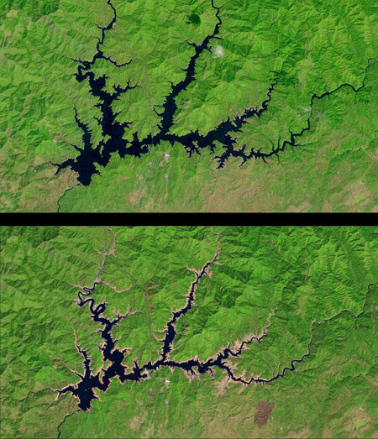
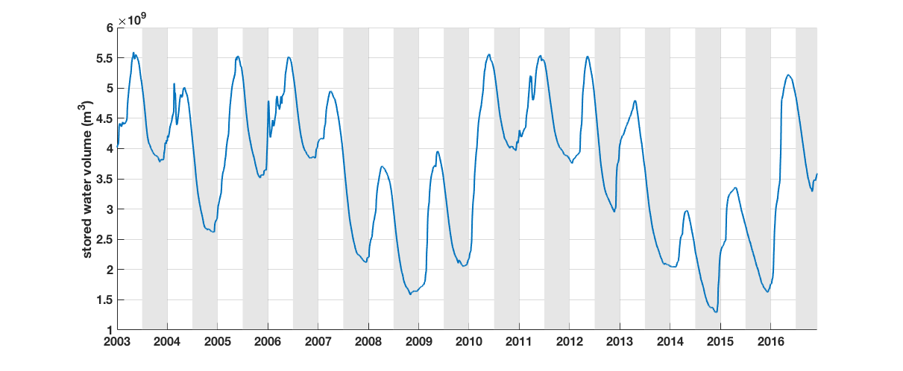
Catastrophic
Shasta: June 2011
Shasta: June 2014
Photo: USGS/NASA
~50% decrease in volume!
Notes:
The drought exposed the vulnerability of our water resources, in particular the reservoir system. This is the time series of Shasta lake is typical of the time series we have analyzed (reservoir volumes vs time), which is available daily from state of california. You notice an annual recharge (in white) and discharge (in black) cycles but in this year 2014, there was barely any recharge cycle. And the image above is evidence where Shasta lake had 50% less water in 2014 than it did in 2011.

Slide 4
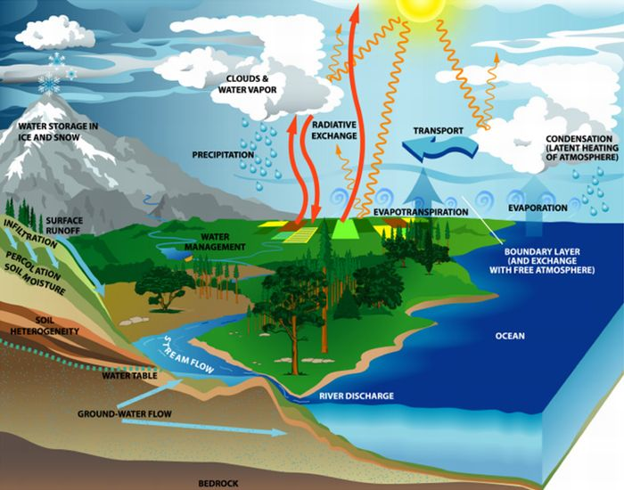
Physics-Based Models Exclude Reservoirs
precipitation cycle
Physics-based models are frontier in Earth Sciences:
characterize
predict
Reservoirs are not
well-modelled
Humans control inflow and outflow based on complex demands:
e.g. hydropower, irrigation
Photo: NASA
Notes:
We would like to understand the response of reservoirs to drought conditions. The bread and butter of hydrology is using physical laws to describe water phenomena. This diagram shows different components of the precipitation cycle. Hydrologists model most of these components via physical laws to characterize the underlying system and predict what happens in the future. Reservoirs however are net well modelled by physical processes. The behavior of these reservoirs is not solely determined by physical laws of the water cycle, but also by demands and what these reservoirs are being used for. The significant human component behavior of reservoirs means that physics-based modeling quickly becomes intractable in settings with large number of reservoirs

Slide 5
Scientific Objectives
Statistical modeling of the California reservoir network based on historical observations of reservoir volumes to:
characterize interdependencies of California reservoirs and factor influencing the network
predict future response
Shasta Dam, California
Notes:
So our objective is to develop statistical model of the California reservoir network based on historical observations of reservoir volumes to a) characterize factors influencing the network. With this model at hand, we then want to predict the future response of the network so that we can make more informed policies.

Slide 6
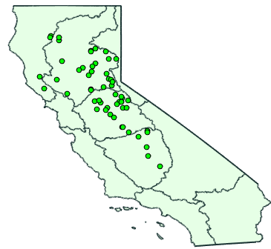
California Reservoir Network
55 representative reservoirs in 4 hydrological zones
Hydrological heterogeneity
Highly interconnected
Sacramento
North Coast
San Joaquin
Model must be:
faithful to hydrological attributes
concise and interpretable
Tulare
efficiently computable
Shasta Reservoir, California
Notes:
We consider the network of 55 representative reservoirs shown in green dots that reside in 4 different hydrological zones. As you can imagine, there is many hydrological attributes that contribute to the behavior of reservoirs: such as elevation, draignage area and spatial location. this is a highly interconnected network with lots of dependencies between reservoir. Further,
So we want our model to respect the hydrological attributes of the network, be concise and interpretable, and be efficiently computable.

Slide 7
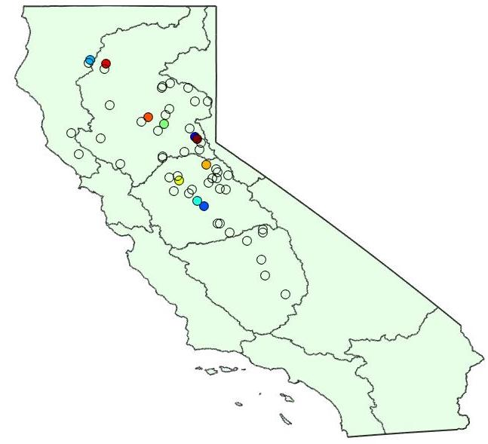
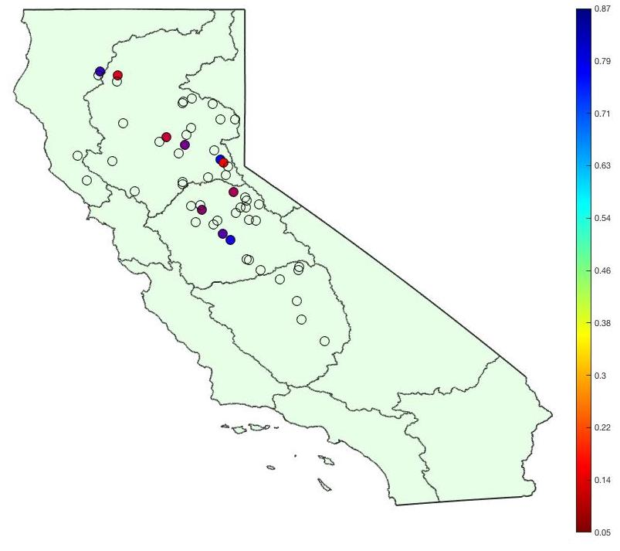
Classical Statistical Methods Fail
California Reservoir R² values
Linear Model: Each reservoir volume is a linear combination of other reservoir volumes
Measure performance by R² – fraction of variance explained by the model (R² = 1 is best)
Model fails: Too many free parameters
(Empty circles have negative R², meaning worse-than-constant)
Notes:
A natural modelling framework is a big linear regression model where we predict one reservoir volume based on a linear combination of the other reservoirs. This problem is easy to solve and you can evaluate the performance with a metric called the coefficient of determination – otherwise as R^2- that represents the percentage of variation for a reservoir volume that can be explained by the model. R^2 = 1 means that the model perfectly fits the data, and R^2 < 0 means that the model does a very poor job. The figure in the right shows the R^2 values for the collection of reservoirs we are considering. Notice for most of them ithe model is very poor with very few above 0.5.
The reason is that there are simply too many parameters. N reservoirs and thus N^2 free parameters and there is just not enough data.

Slide 8
Network with Latent Variables
external factors (rain? snowpack?)
Summarizes influence of external variables
don’t know what they are
latent variables
A weight (partial correlation) is associated with each edge in the network
Don Pedro
Shasta
Don Pedro
Shasta
Almanor
Almanor
San Joaquin
Summarizes the relevant influence of other reservoirs
San Joaquin
Sacramento
Sacramento
New Melones
New Melones
Buchanan
Antelope
Buchanan
Antelope
Isabella
Isabella
Pine Flat
Pine Flat
Tulare
Tulare
Nodes : reservoirs Solid Edges: interactions between reservoirs
Cloud node: latent vars. Dotted Edges: interactions with latent vars.
https://github.com/armeentaeb/WRR-Reservoir
Notes:
Since we are scientists, we aspire to ideal models. I’m going to describe the ideal model for the reservoir network. Consider a toy example of this model over 8 reservoirs that is represented by green nodes in this graph. They are categorized according to their respective hydrological zone which is shown sthe gray ovals. Since the reservoir network is interconnected, we denote these interactions with blue edges in the graph. To have a simple and interpretable model, we want a sparse graph, with small number of interactions. where we want most of the interactions to happen with reservoirs in the same hydrological zone
Now, there are external factors influencing the network (such as rain, snowpack, policies) but the number of explanatory variables and their influence is unknown. We denote these as latent variables: they summarize all the information of explanatory variables influencing the network. So our crazy idea is : given a network, we want to identify the effect of these latent variables (these uknown things) while also characterizing sparse interactions between variables in the network. It turns out that this ideal model is attainable!
ese

Slide 9
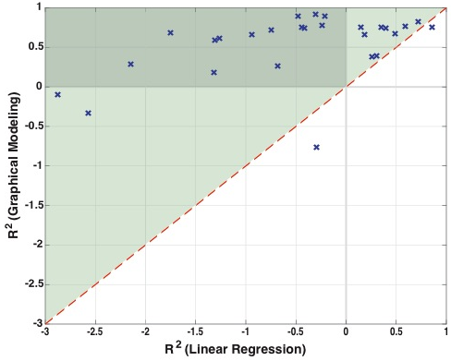
Our Model Works
Goodness of Fit for Each Reservoir
R² now closer
to 1
Larger R²
is better
All but two reservoirs show better fit (green shaded triangle) Many show vast improvements (shaded rectangle)
Notes:
What you see here is a slide on how well sparse graphical modeling works. Here is a scatterplot where each cross denoted the R^2 of the reservoir in our set. Anything above the dotted red line means that we did a better job with a sparse model than with the old classical model. There are a bunch or reservoirs (shown n the dark green region) that have R^2 close to 1 that weren’t even modeled via classical models. So we can see that the goodness of fit is massively improved

Slide 10
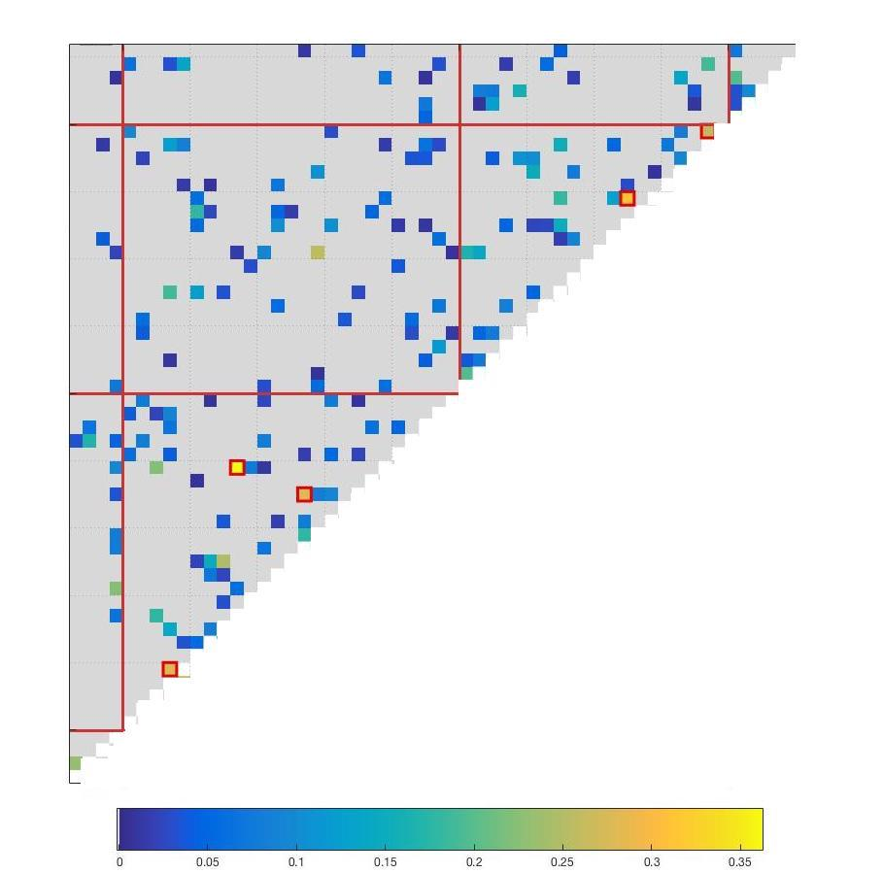
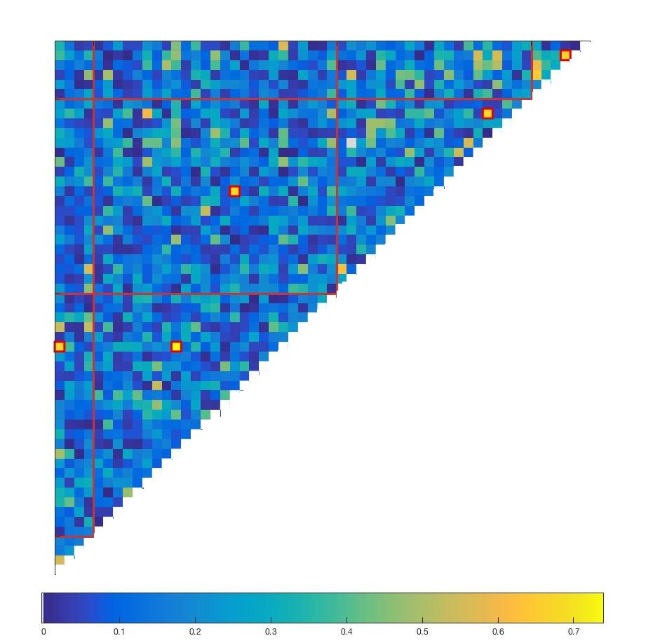
Model Output
N.
Coast
N.
Coast
Sacramento
S. Joaquin
Tulare
Model parameters
2 latent variables
171 edges (~ 0.1 of the total possible)
Sacramento
San Joaquin
Tulare
Tulare
Tulare
S. Joaquin
Concise and interpretable:
Lower (linear regression) – Upper (our model)
Can read off interdependencies
within zone edge strength/total edge strength = 0.86
S. Joaquin
Sacramento
Sacramento
Edge Strength
Edge Strength
N.
Coast
N.
Coast

Slide 11
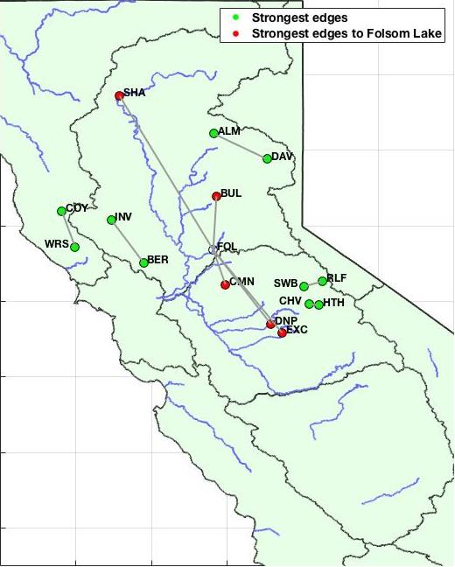
Exploring Network Edges
Folsom is the most connected reservoir
4/5 of the strongest edges are pairs of reservoirs fed by same river

Slide 12
Latent Variables of Reservoirs
We can rank most important variables
Covariate | Correlation
Palmer Drought Index (PDSI) | 0.88
Hydroelectric Power | 0.80
Sierra Nevada Snow Pack | 0.50
Colorado River Discharge | 0.29
Agricultural Output | 0.17
Notes:
So we apply this framework and we find that two latent variables influence the reservoirs. So you may ask, what are these latent variable? you can posit that agriculture is an important factor cause they draw water, or the sierra snow pack is the leading driver of reservoir behavior. Using our procedure you can quantify, in a rigorous manner, how much each of these variables are correlated to the latent variables. We quantify the amount of correlation of physical quantities with the latent variables, and see that the Palmer severity drought index is the most important factor of the reservoir network. Palmer severity drought index is a hydrological indicator of drought that is a combination of precipitation and temperature.

Slide 13
Implications I
Precisely characterize forcing to PDSI
statewide response to drought
Rule of Thumb:
If reservoir exhaustion above 50%, heavy management needed
Danger
Notes:
So we can precisely characterize the influence of PDSI on the statewide reservoir network. In this plot, we have drought index on the x-axis, where more negative meaning stronger drought, and probability of exhaustion on the y-axis. The blue curve is the probability that at least one reservoir goes dry, and the black is the probability that at least two reservoir goes dry. We see that in 2015, there was greater than 50% chance that at least one reservoir goes dry. We believe that this result serves as a very useful tool to make more informed policies. In particular, the nice feature of the drought index is that we typically have advanced prediction of it. So we propose the following rule of thum: Let's say you're in a drought and you have an advanced prediction of the drought index value in two months, ou can look at our plot and ask, 'Okay, what is the likelihood of reservoir exhaustion if we just stick to business as usual?' And if you see that it's high, you need to get out of your routine and do something now before you get in trouble.

Slide 14
Implications II
Buchanan and Hidden Dam most at risk!
individual response to drought

Slide 15
Model Accurately Predicted
Hidden Dam
Buchanan
Heavy Management
Don Pedro
Moderate Management
Predicted Risk of Exhaustion in 2015 = 0

Slide 16
Implication III
Don Pedro
Model Prediction
Hetch-Hetchy

Slide 17
Summary and Ongoing Work
First model of the California reservoir network
Network modeling with latent variables
concise, interpretable, and efficiently computable
Categorize reservoirs into boundaries based on interdependencies
Data driven approach to characterize policy effect

Slide 18
Relevant Papers
Taeb & Chandrasekaran, Interpreting Latent Variables in Factor Models via Convex Optimization, Mathematical Programming, 2017
Taeb et al., A Statistical Model of the California Reservoir Network, Water Resources Research, 2017
Code at https://github.com/armeentaeb/WRR-Reservoir

Slide 19
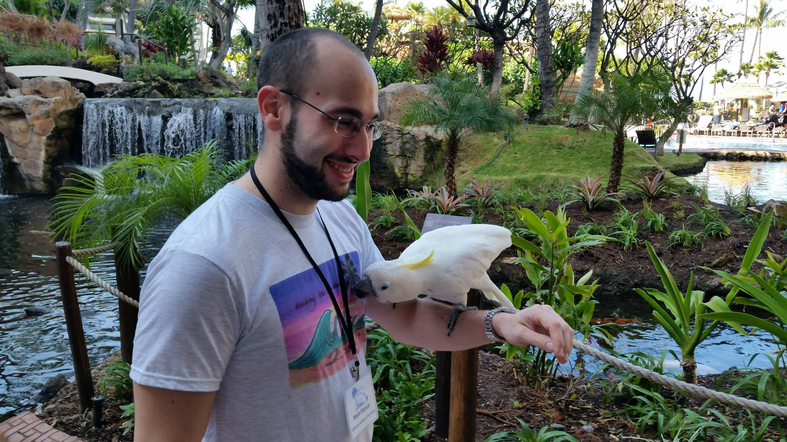



SEED Insights
To provide constructive, data-driven, and interactive insights into climate change and sustainability for a scientifically engaged audience.
Noah Olsman
Irene Farr
Donal O’Sullivan
Cathrine Alvarez

Slide 20
Thank You!

Slide 21
Backup Slides

Slide 22
Magic of Convex Optimization
Natural optimization problem to solve:
Convex optimization problem with unique optimum!
This algorithmic framework identifies :
interactions between observed var.
latent vars. underlying network
response to latent var. forcing
x
Optimum is guaranteed to be correct [T. et al, 2017; C. et al, 2012]
Notes:
This is where mathematics and the magic of convex optimization comes into the picture! There is a very natural optimization problem to solve to fit data to a latent variable graphical model. It is is to minimize over the space of models the error in fitting to data, subject to that model being a latent variable graphical model. The crazy thing is that under a reformulation, we can formulate it to be a convex optimization problem with a unique optimum. What that means that this problem essential boils down to minimizing a bowl shape function, where you can start at any point, and follow the gradient of the function down to the global minimum. Furthermore, we show that at the global minimum, which we are guaranteed to reach, we can precisely characterize interactions between observed variables, identify latent variables influencing the network, and the response to latent variable forcing. In summary, we have made something that seemed far fetched to be possible.

